Slide 1
Team 9
{Rupali,Sowmya}

Slide 2
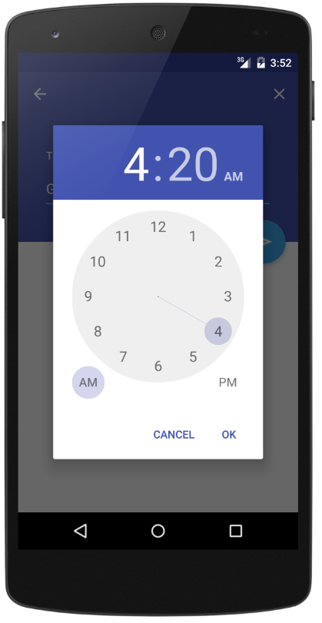
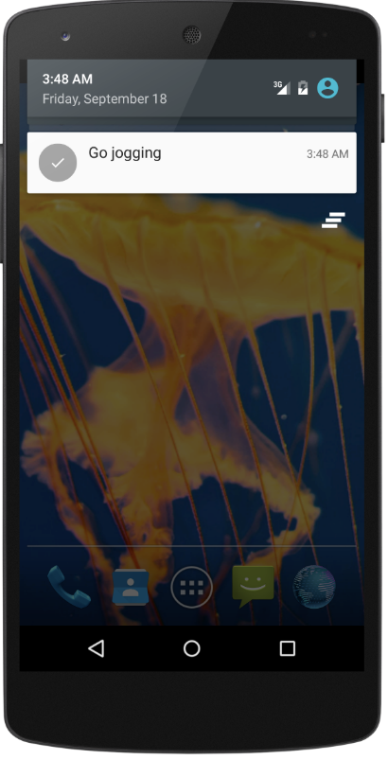
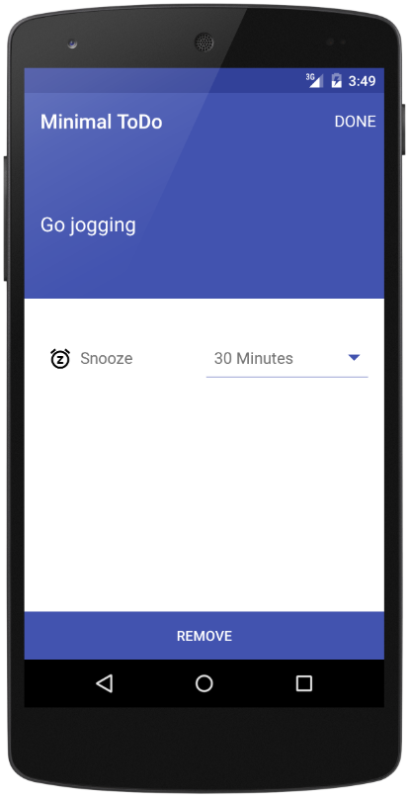
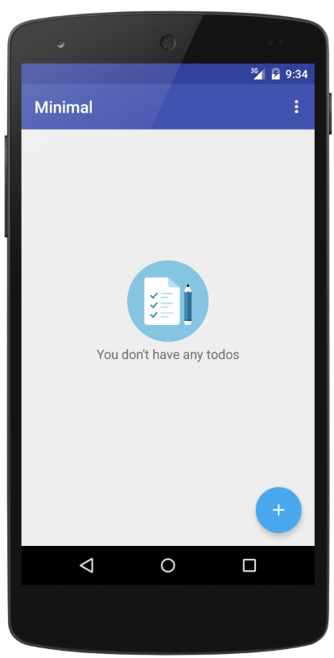
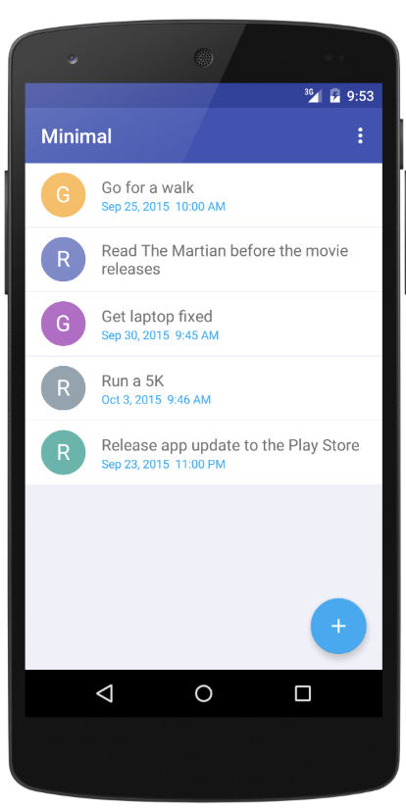
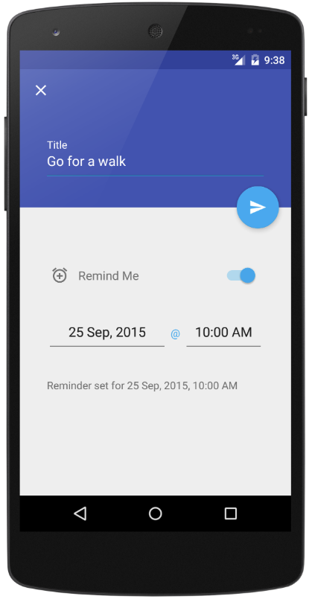
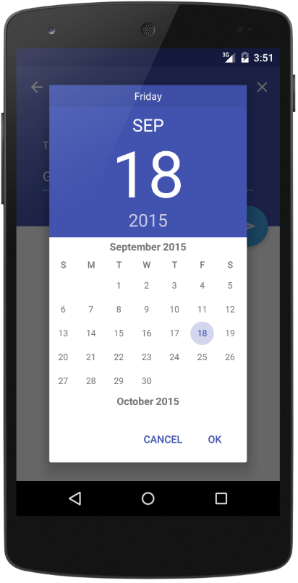
Android Minimal - TODO
https://github.com/avjinder/Minimal-Todo

Slide 3
JUnit and Mockito Overview
Mockito is a popular mock framework which can be used in conjunction with JUnit. Mockito allows you to create and configure mock objects. Mockito is an open source testing framework for Java. The framework allows the creation of test mock objects in automated unit tests for the purpose of test-driven development(TDD) or behavior-driven development(BDD).
Benefits of Mockito:
No Handwriting − No need to write mock objects on your own.
Refactoring Safe − Refactoring will not break the test code as Mocks are created at runtime.
Return value support − Supports return values.
Exception support − Supports exceptions.
Order check support − Supports check on order of method calls.

Slide 4
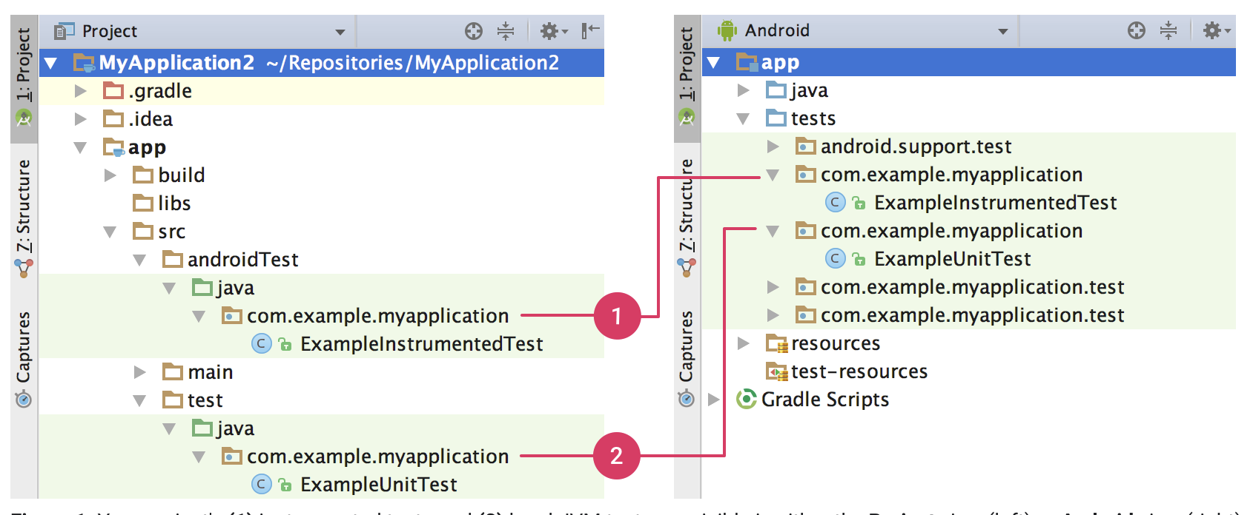
Instrumented tests Vs Local unit test
Local Unit tests - Located at module-name/src/test/java/.
These are tests that run on your machine's local Java Virtual Machine (JVM).
These tests to minimize execution time - no Android framework dependencies, can mock Android Framework This lets you use popular mocking libraries, like Mockito.
Integrated tests - Located at module-name/src/androidTest/java/.
These are tests that run on a hardware device or emulator.
These tests have access to Instrumentation APIs, gives us access to the context of the application and we can control app under test.
Used when writing integration and functional UI tests to automate user interaction, or when tests have Android dependencies that mock objects cannot satisfy

Slide 5
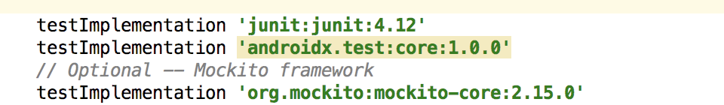
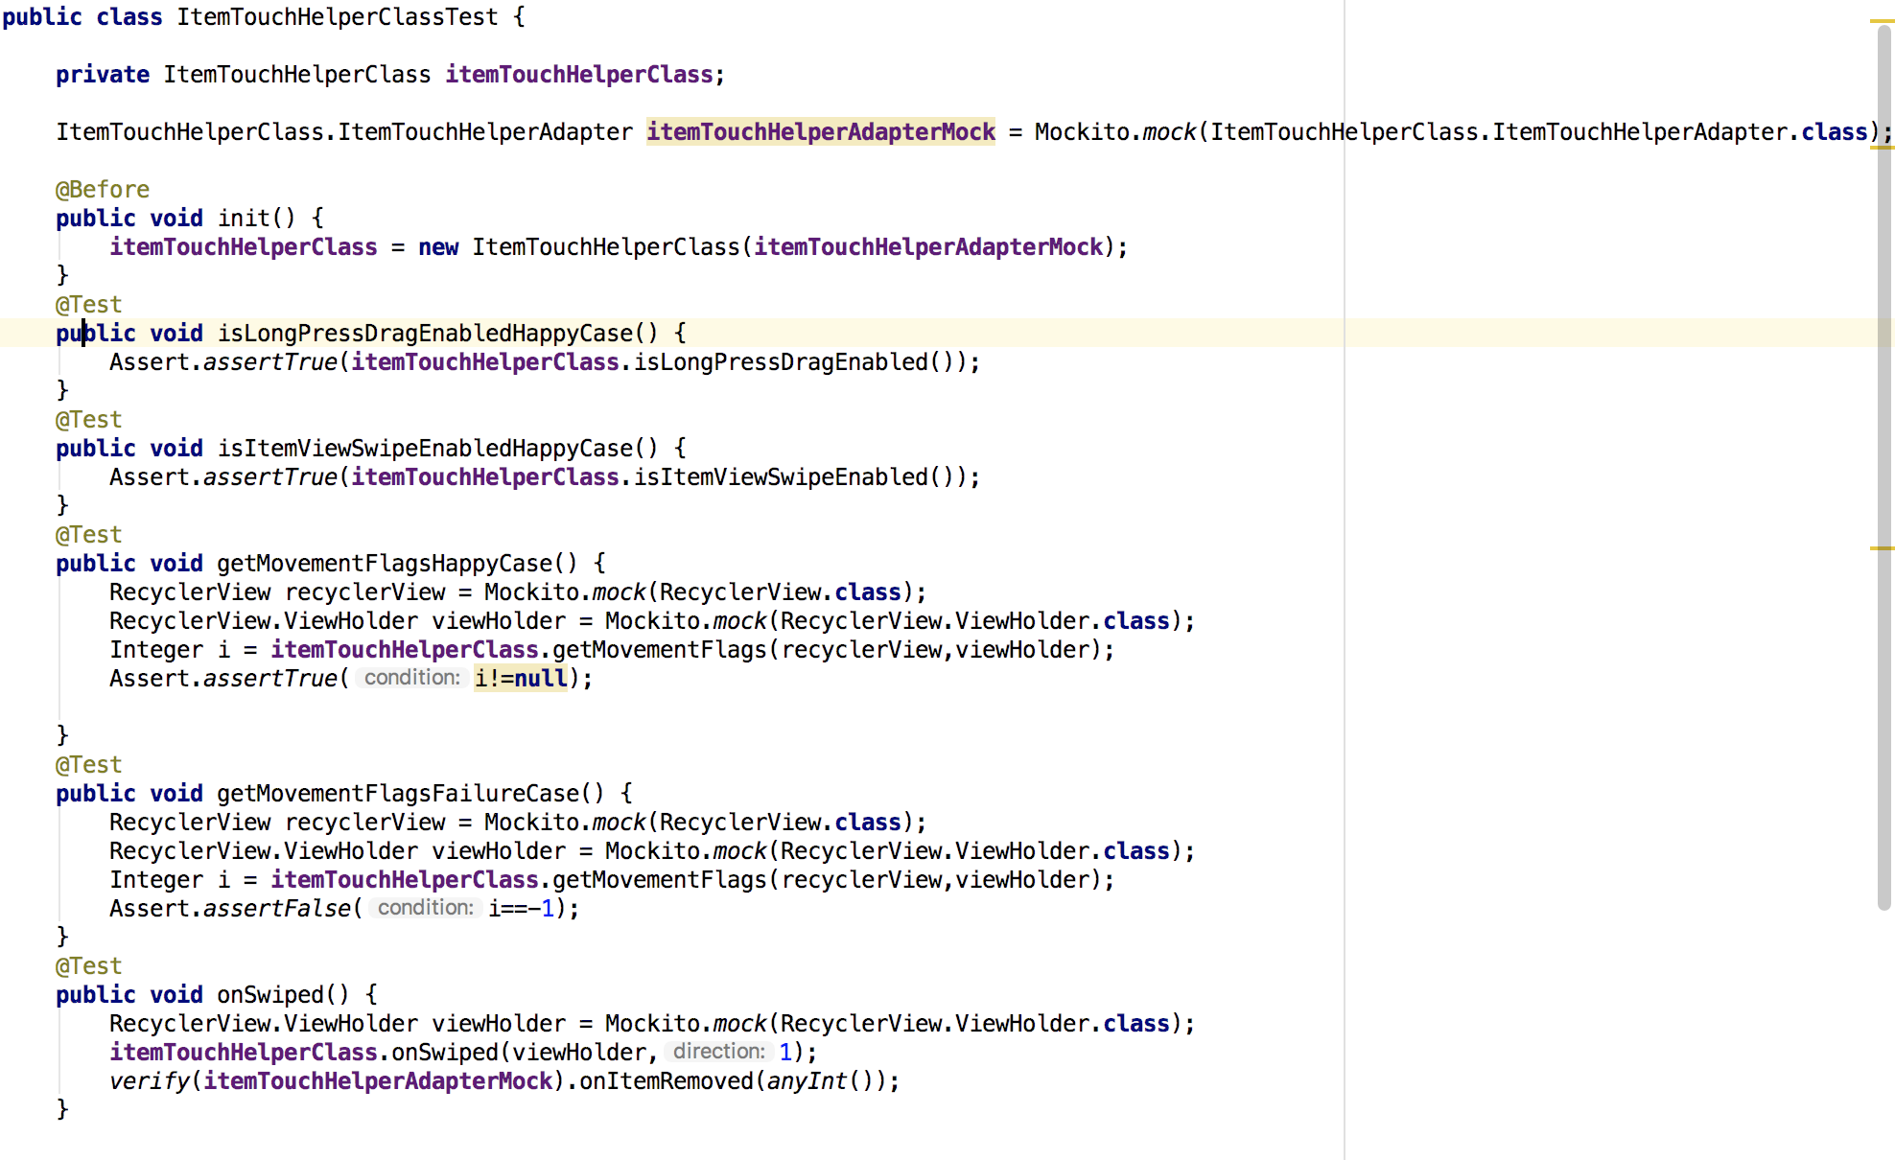
JUnit Code Snippets
Dependencies Test cases

